Slide 1
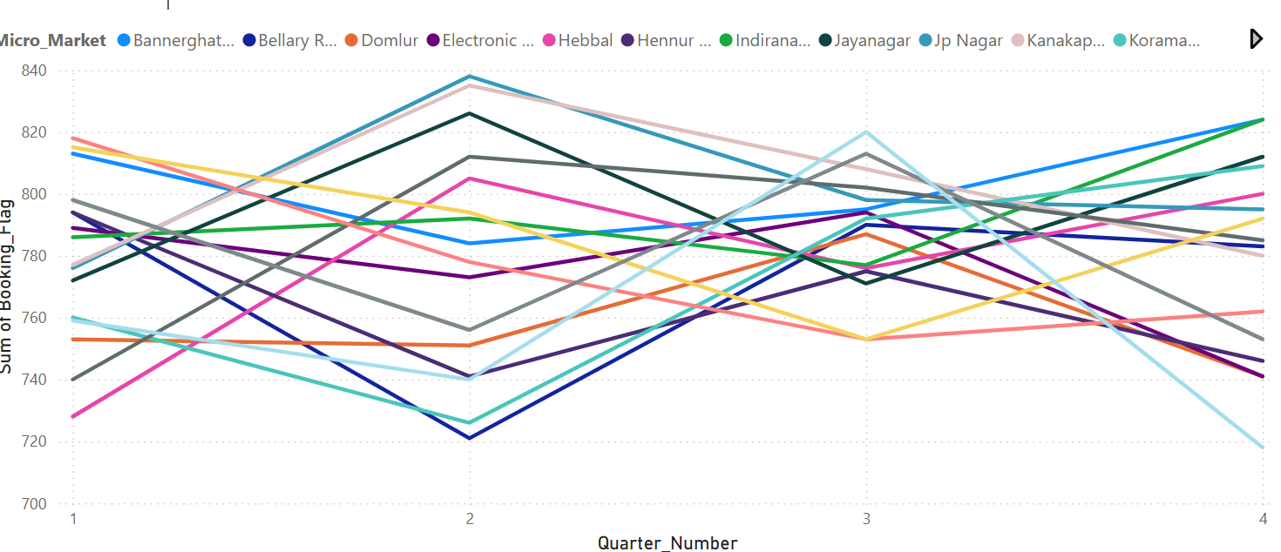
Market Trends
How have luxury housing bookings changed quarter by quarter across micro-markets? → (Line Chart with Quarter on X-axis and Booking_Count on Y-axis, segmented by Micro_Market)
1. Overall Trend
Bookings fluctuate across quarters with noticeable peaks in Q2–Q3.
2. Strong Micro-Markets
[e.g., Whitefield, Hebbal] consistently lead in bookings → strong demand zones.
3. Weak Micro-Markets
[e.g., Bannerghatta Road, Hennur] show slower growth → need deeper analysis.

Slide 2
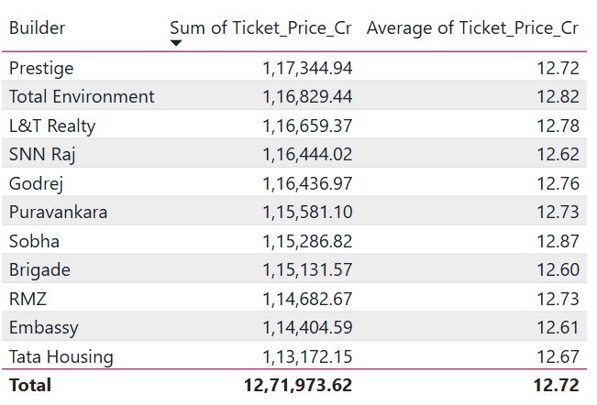
Builder Performance
Which builders have the highest total ticket sales and how do they rank in terms of average ticket size? → (Bar Chart or Table showing Builder, Sum(Ticket_Price_Cr), Avg(Ticket_Price_Cr))
Prestige & Total Environment dominate in total sales → strong brand trust & large project pipelines.
Sobha excels in premium pricing → niche luxury segment focus.
Builders like RMZ, Embassy, Tata Housing maintain mid-level averages but contribute significantly to volume.

Slide 3
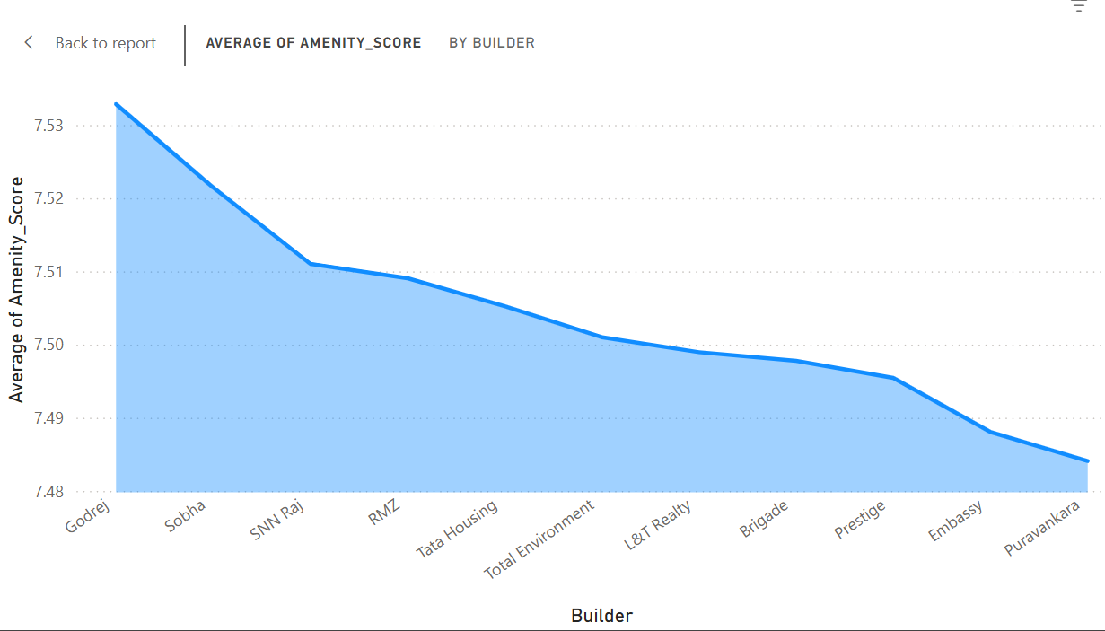
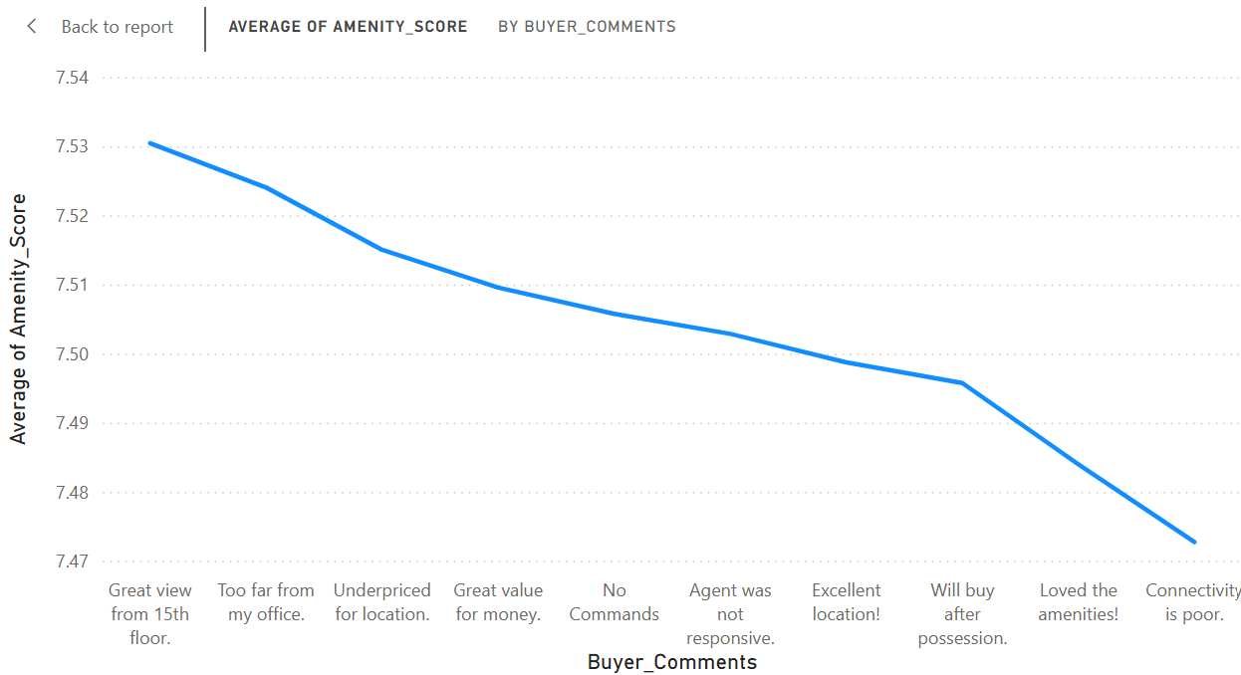
Amenity Impact
Is there a correlation between amenity score and booking success rate?
Amenity Score matters — it clearly influences buyer sentiment and builder brand perception.
Builders with higher amenity scores (e.g., Godrej, Sobha) also likely enjoy higher booking conversion rates.
Negative buyer comments (connectivity, agent issues) drag down scores even if amenities are good.

Slide 4
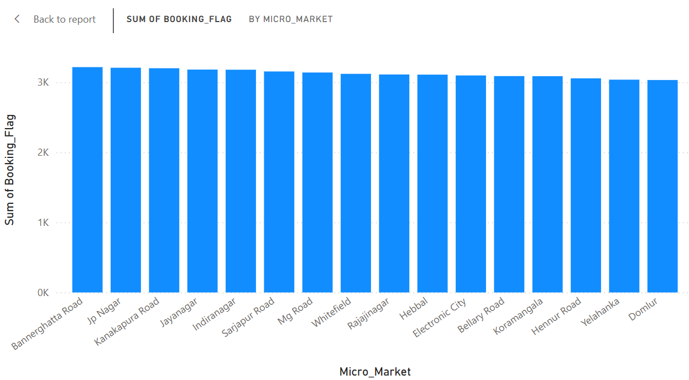
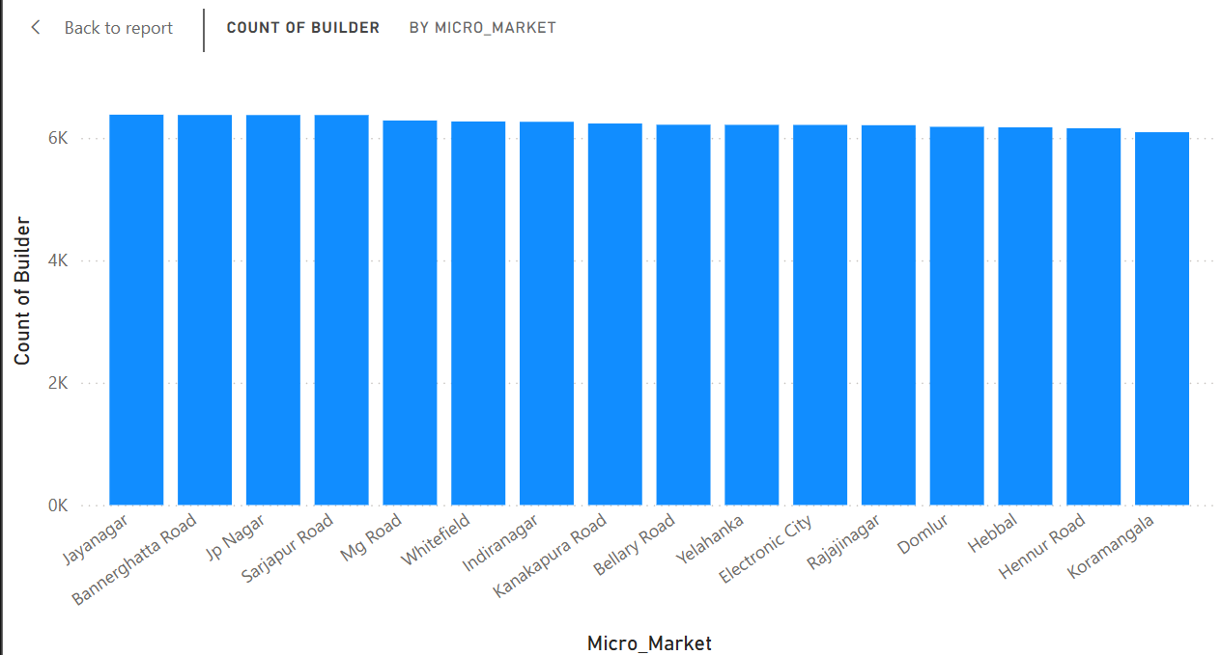
Booking Conversion
Which micro-markets have the highest and lowest booking conversion rates?
Luxury housing demand is balanced across micro-markets, but a few stand out slightly.
South Bangalore markets (JP Nagar, Jayanagar, Bannerghatta Road) show stronger booking conversion rates.
Builder competition is evenly spread, but demand does not always rise with builder count — highlighting the role of location attractiveness and builder reputation.

Slide 5
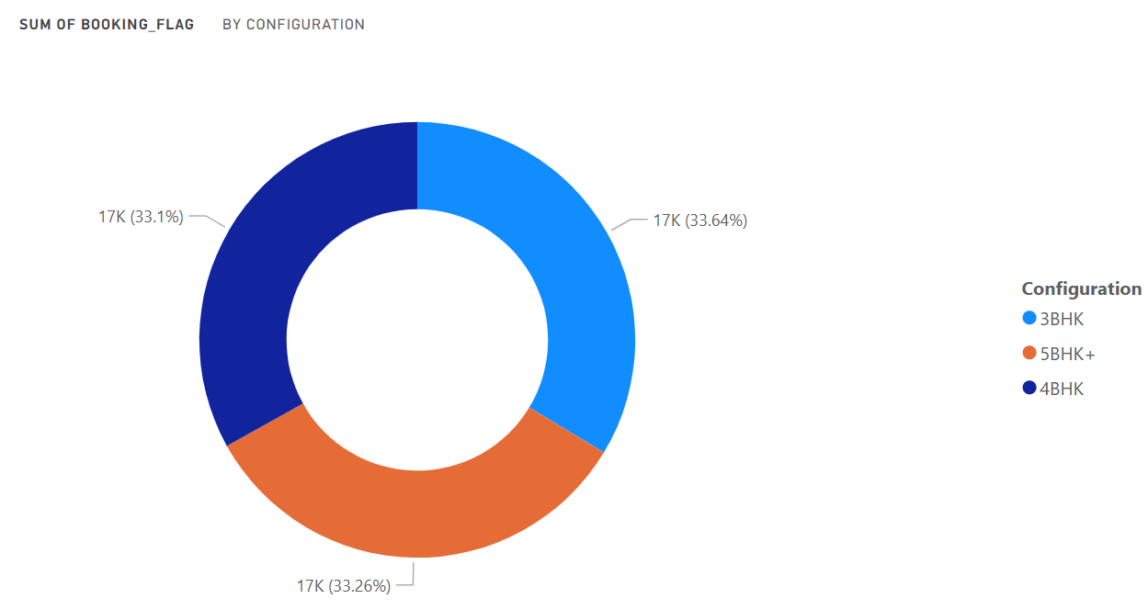
Configuration Demand
What are the most in-demand housing configurations (e.g., 3BHK, 4BHK)?
Demand is evenly distributed between 3BHK, 4BHK, and 5BHK+.
This highlights a diverse buyer base — from nuclear families (3BHK) to affluent segments seeking larger luxury homes (4BHK & 5BHK+)
With 33.6% share, 3BHK is the most popular choice. It reflects the sweet spot for nuclear families seeking affordability + comfort.

Slide 6
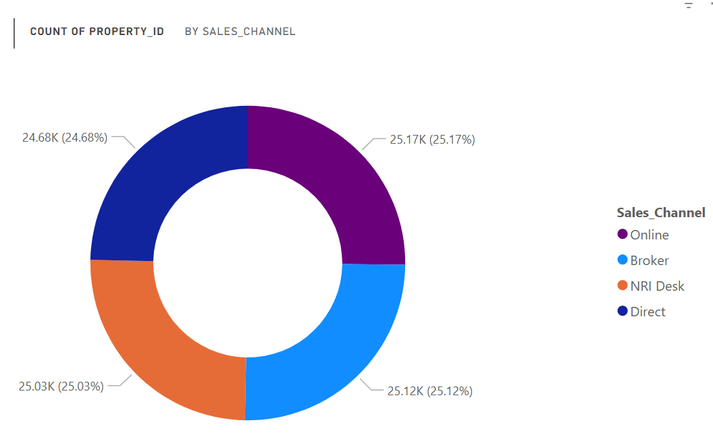
Sales Channel Efficiency
Which sales channels contribute most to successful bookings?
Unlike many industries where one channel dominates, here the market shows a well-diversified sales approach.
All four sales channels — Online, Broker, NRI Desk, and Direct — contribute almost equally (~25% each) to successful bookings.
This balance indicates that buyers are engaging through multiple touchpoints — digital, direct, intermediaries, and specialized NRI desks.
Builders should continue investing across all channels instead of relying on just one.

Slide 7
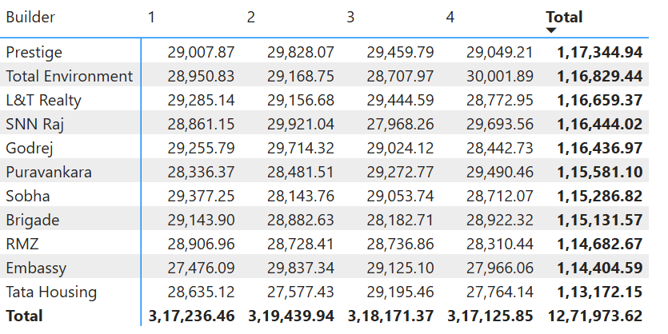
Quarterly Builder Contribution
Which builders dominate the market each quarter?
Prestige leads with the highest total contribution (~₹1.17L Cr), followed closely by Total Environment and L&T Realty. These three consistently dominate across all four quarters.
Most builders show stable contributions every quarter, with only minor fluctuations.This indicates sustained demand and strong market presence across the year
Even the lower-ranked builders (Embassy, Tata Housing) maintain significant contributions (~₹1.13–1.14L Cr), showing the luxury market is diversified and not overly dependent on a single player.

Slide 8
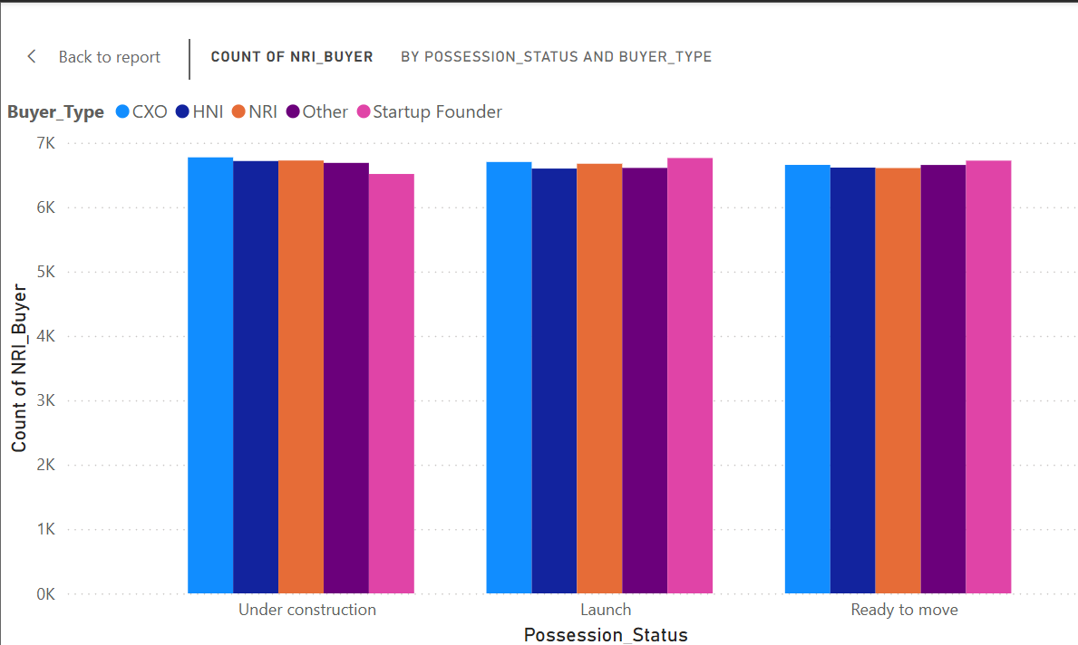
Possession Status Analysis
How does possession status affect buyer type and booking decisions?
Attract slightly more CXOs and NRIs, likely due to long-term investment outlook and willingness to wait for possession.
Shows strong appeal among Startup Founders and HNIs, who may be early adopters seeking price advantages.
Preferred by end buyers (e.g., HNIs and CXOs) who want certainty and immediate usage.

Slide 9
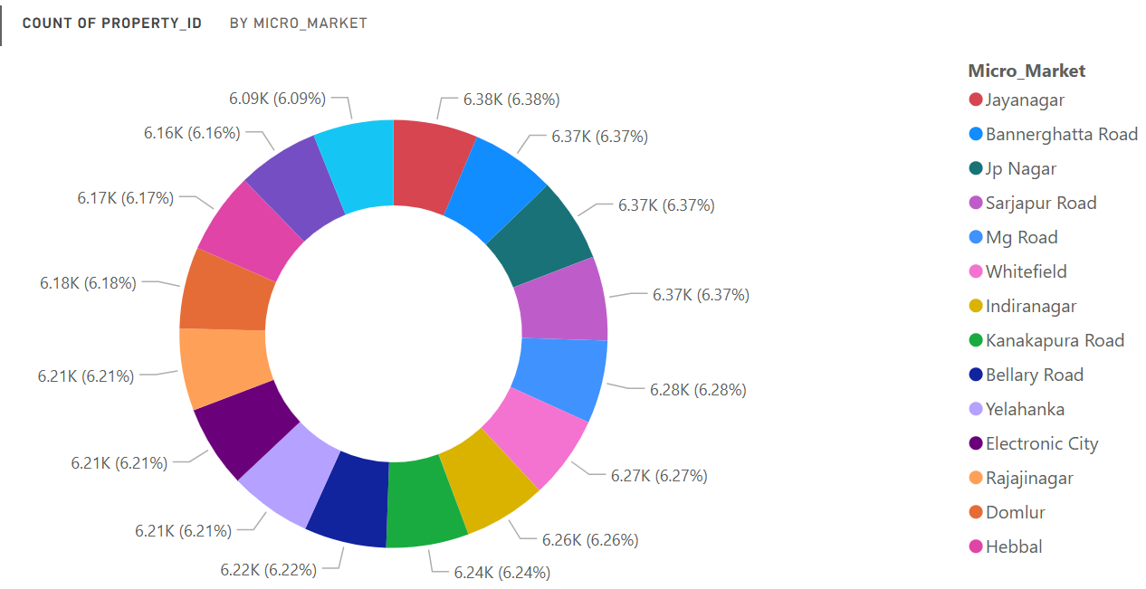
Geographical Insights
Where are most luxury housing projects concentrated within Bangalore?
Luxury housing is not limited to one area; it’s strategically spread across multiple micro-markets.
Top IT and well-connected hubs (Whitefield, Sarjapur, Electronic City, Hebbal) are the primary magnets for luxury housing demand.
This spread ensures developers tap into diverse buyer segments across the city

Slide 10
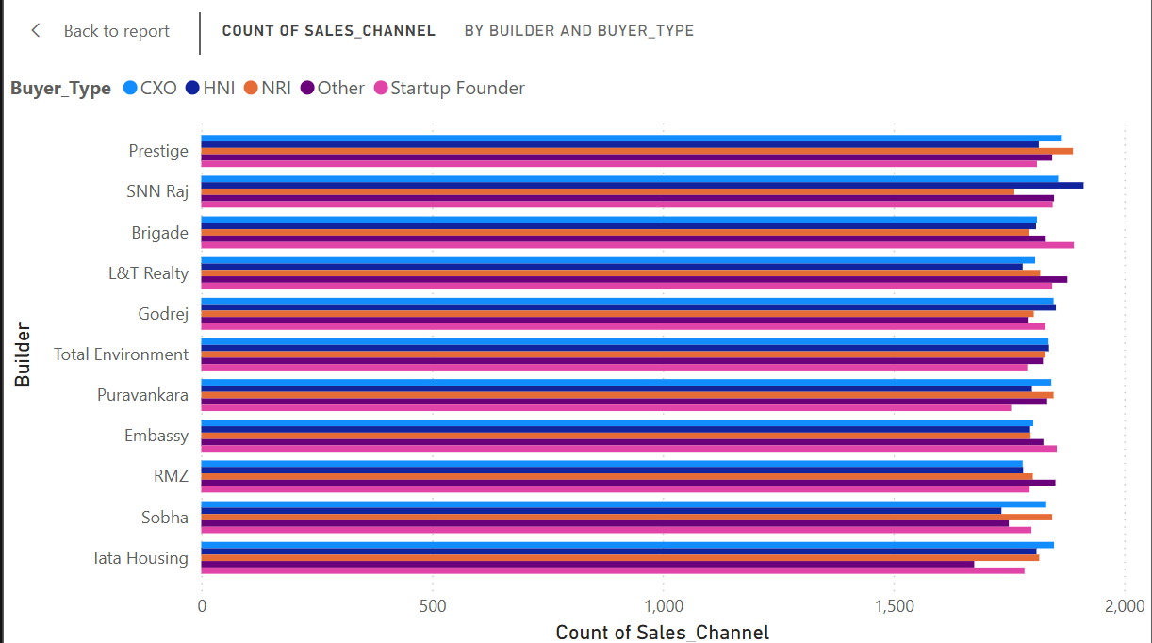
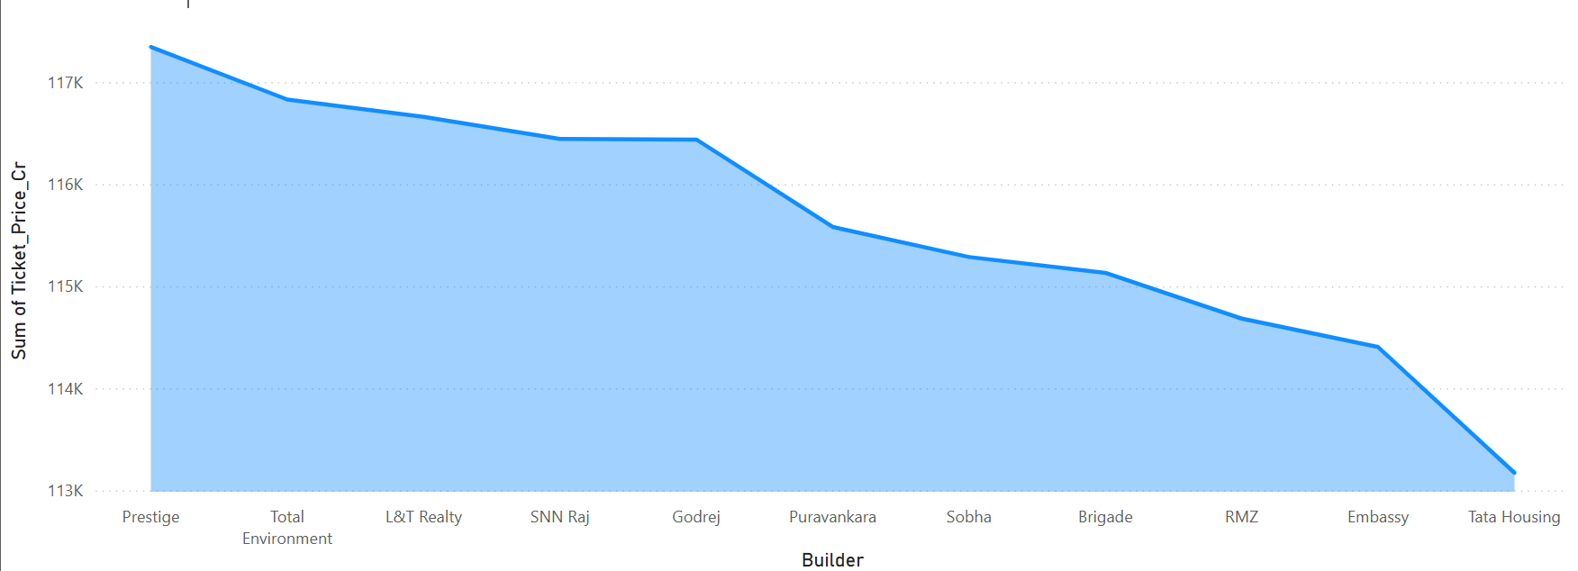
Top Performers
Who are the top 5 builders in terms of revenue and booking success?
Prestige leads with the highest revenue (~117K Cr). Followed by Total Environment, L&T Realty, SNN Raj, and Godrej. This shows they dominate the luxury housing segment in Bangalore
Across these builders, CXOs and HNIs are the primary buyers. NRI and Startup Founders contribute significantly but at a smaller scale. Prestige and SNN Raj show strong appeal to diverse buyer types, not just one segment.
The market is consolidated among a few top players, with Prestige leading. Buyer mix shows that luxury demand is driven by professionals and NRIs, highlighting premium positioning.

